Slide 2
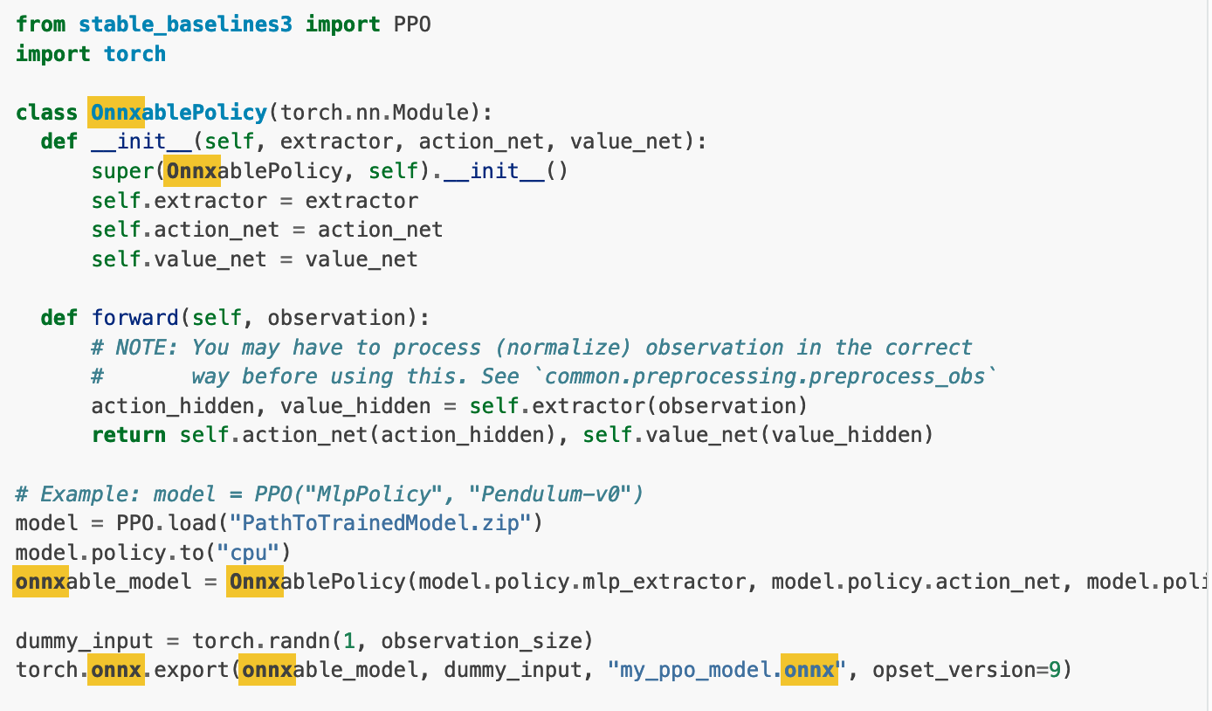
Exporting the model to onnx
From baseline docs

Slide 3
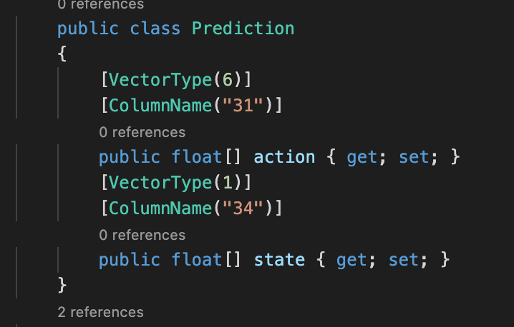
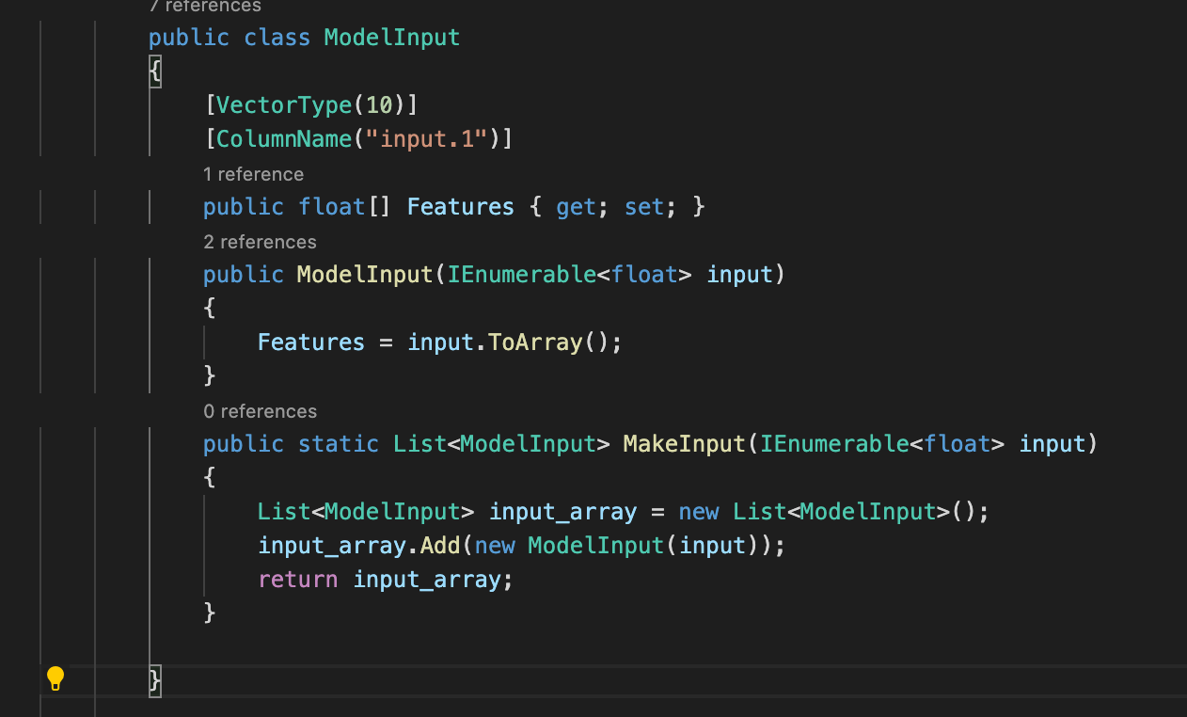
Input output classes for Consupmtion in ML net

Slide 4
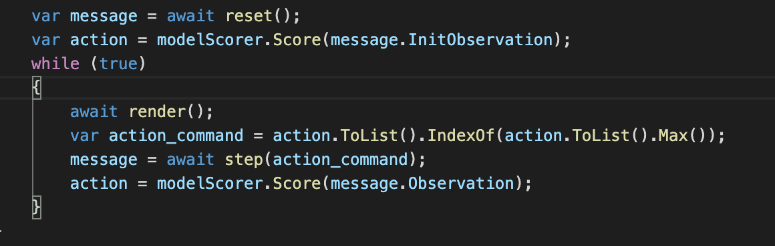
Consuming the model in a websocket server

Slide 5
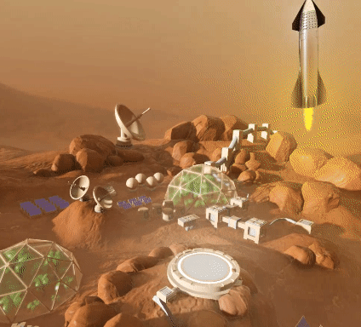
The result

Slide 6
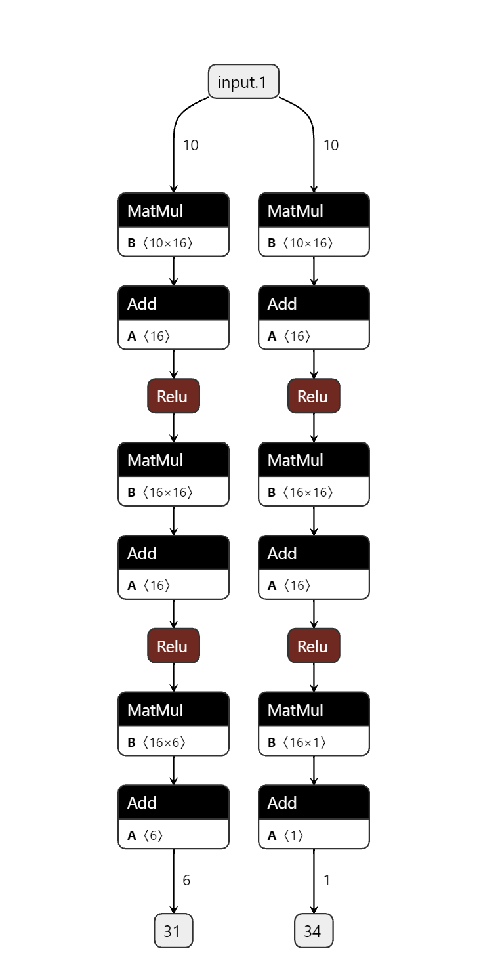
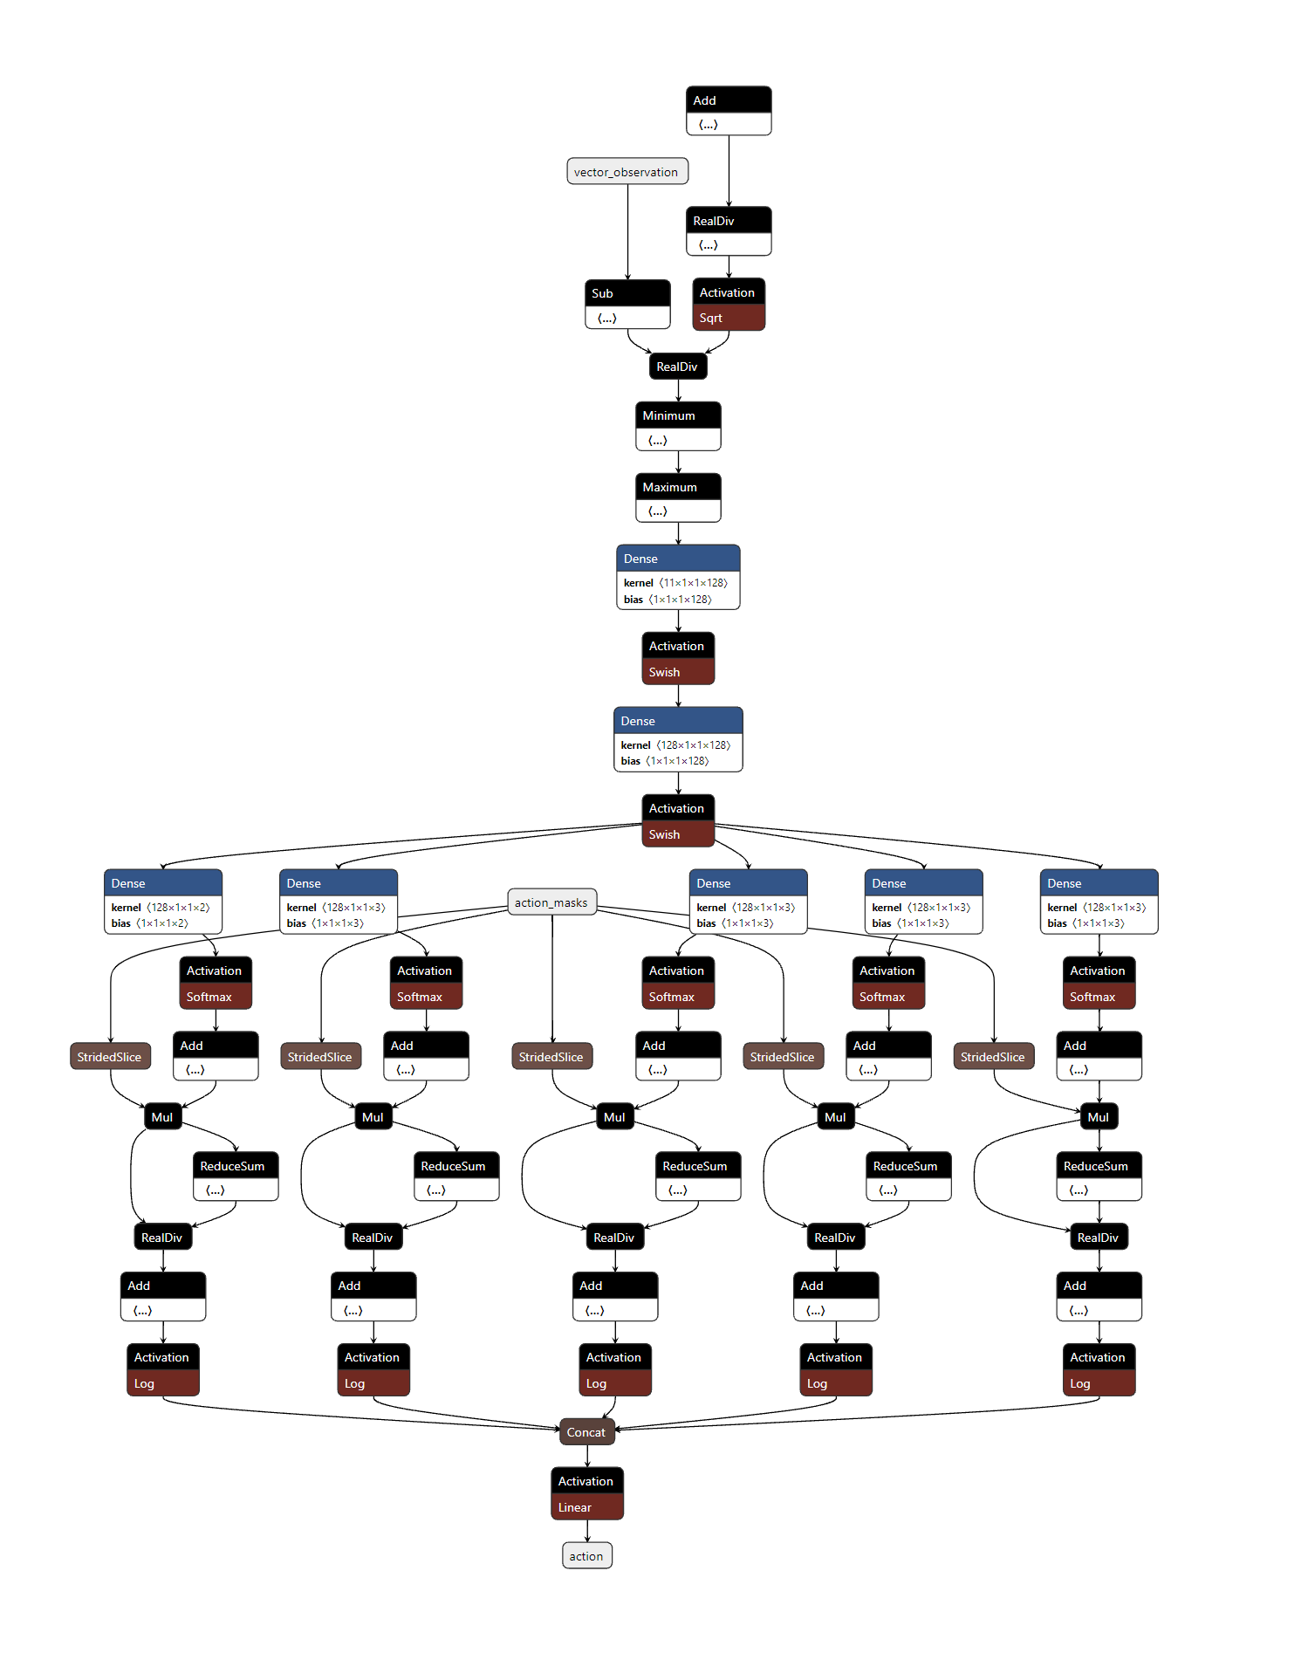
RL-PPO from baseline3
RL-PPO from Unity

Slide 7
The General Workflow
Train a model uisng gym in python.
Export the model to onnx
Write a class to consume the model
Define the correct input and output classes for the model
Make the Transofrmer
Use the transform function to get predictions.
Use the predictions to take actions in godot

Slide 8
Limitations
Python frameworks have a lot of things going on and apparently now everything can be exported to onnx format. E.g
ONNX format doesn’t support exporting models that use the broadcast_tensors functionality of pytorch.
So in order to export the trained stable-baseline3 models in the ONNX format, we need to first remove the layers that use broadcasting. This can be done by creating a class that removes the unsupported layers.

Slide 9
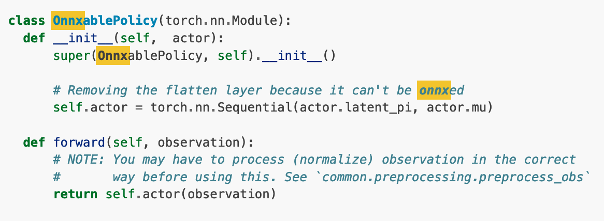
Limitations (cont.)
Example of the class to remove layers from the model

Slide 10
Limitations (cont.)
The output of the model may need to be post-processed when using discrete or binary actions, you must do some post-processing to obtain the action.
Here we convert the array of probabilities the for each action returned by the model to the action based on the maximum probability. (things may not always be this simple tough).
If you have to remove a layer from the model like normlization, you would then add that to your mlnet pipeline and then pass the result as the input to the model.
var action_command = action.ToList().IndexOf(action.ToList().Max());

Slide 11
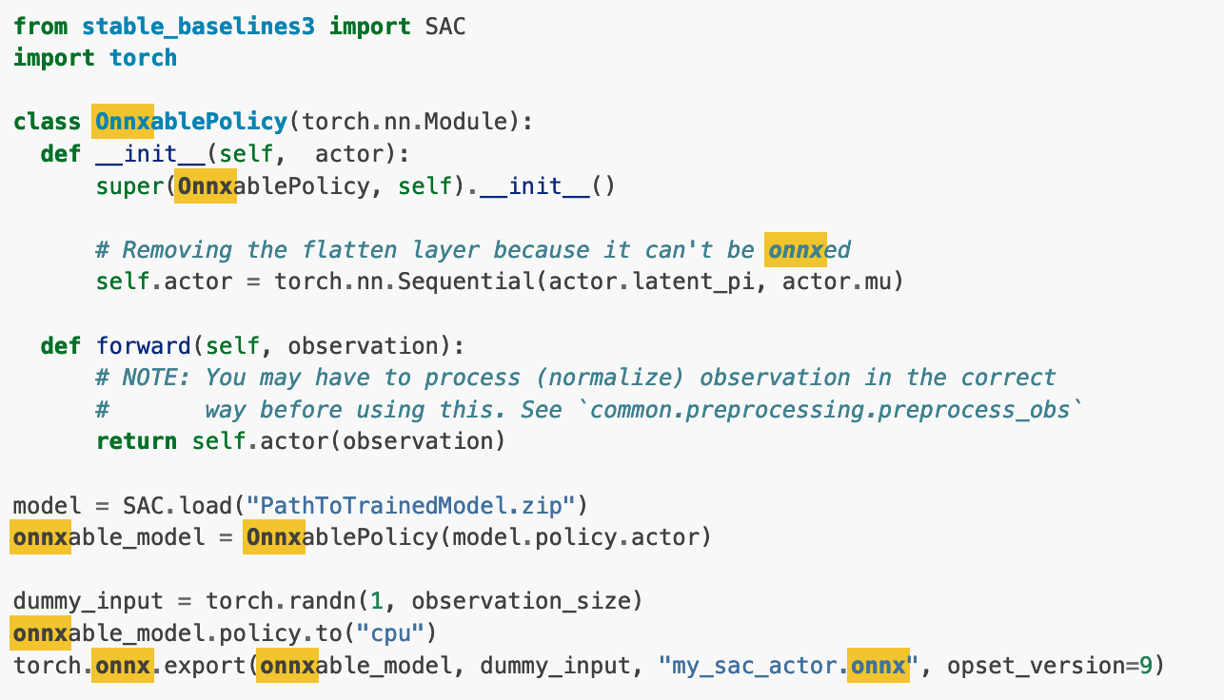
Limitations (cont.)
We were successful with a PPO model and were able to convert an SAC model

Slide 12
Limitations (cont.)
The converted SAC model worked in mlnet but did not give the same results. Which means that either the conversion was wrong or we missed a tranformation. That just goes to show that the conversion is not always simple, or possible.

Slide 13
Alternates
Manually export the parameter weights after the model is trained and construct the network in mlnet

